Slide 1

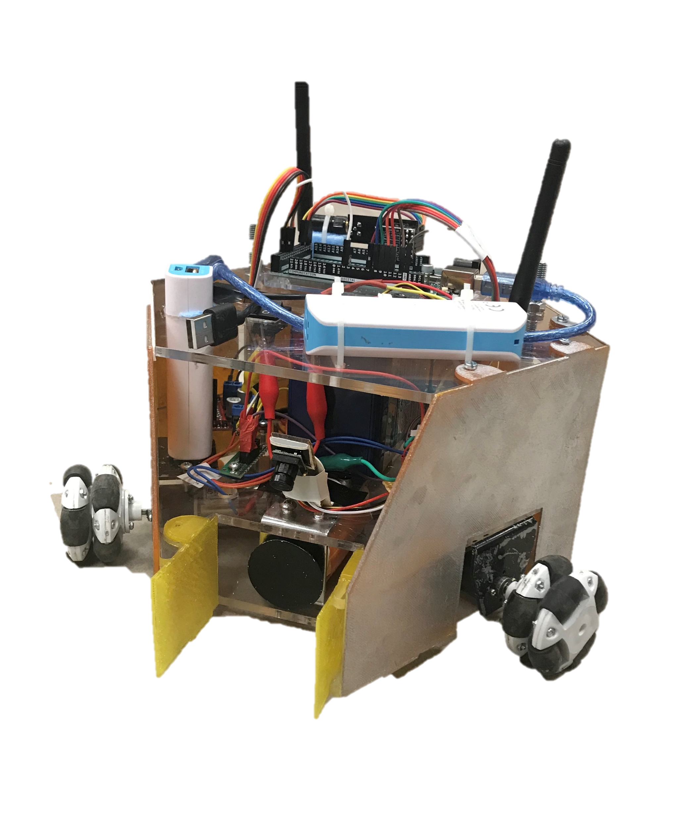
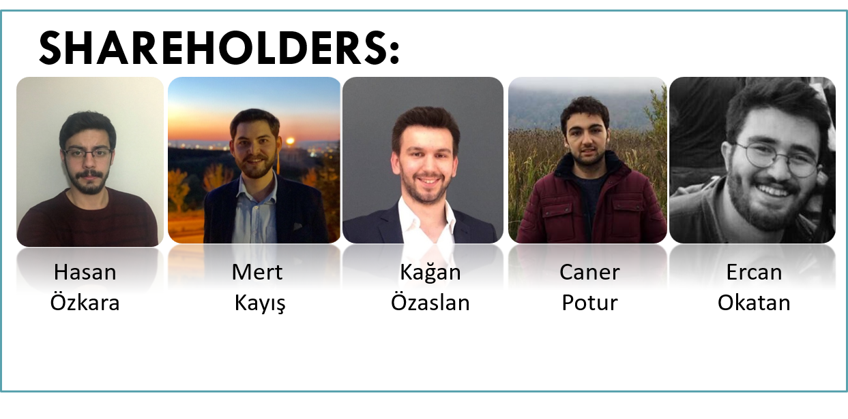
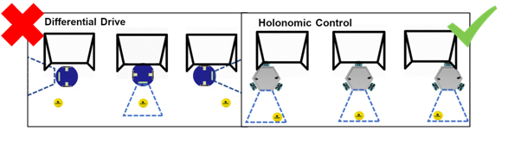
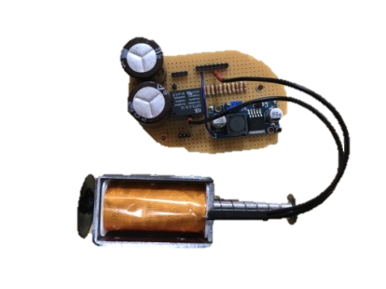
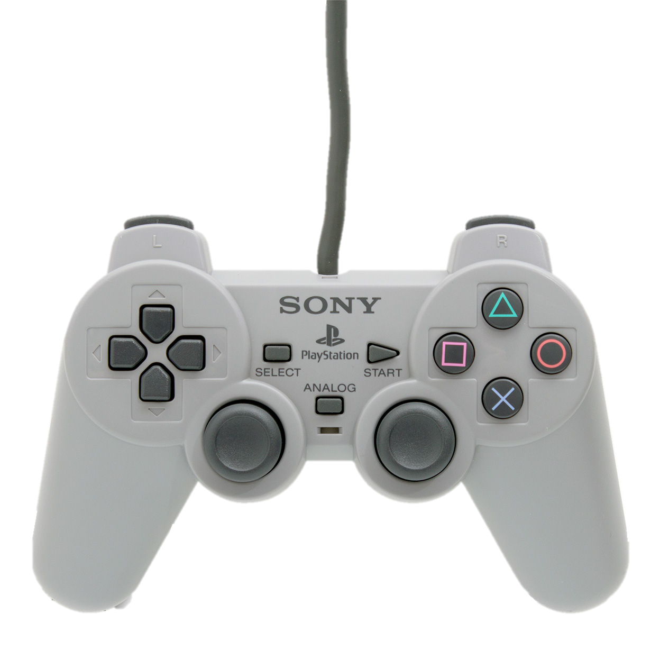
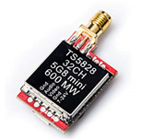
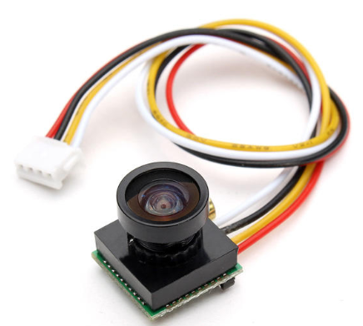
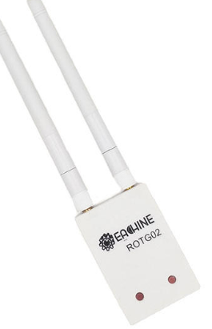
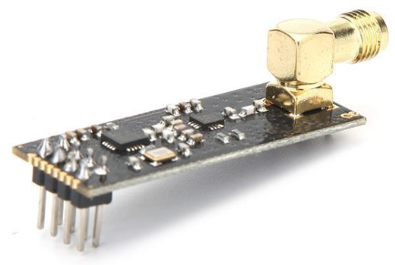
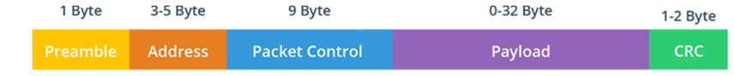
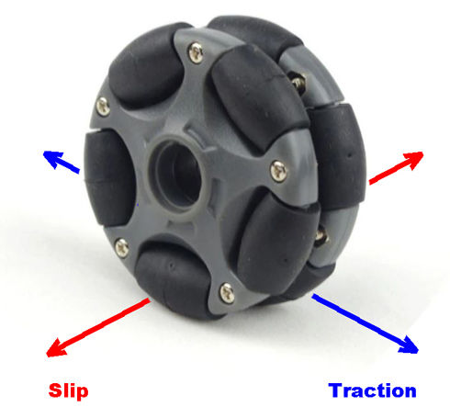
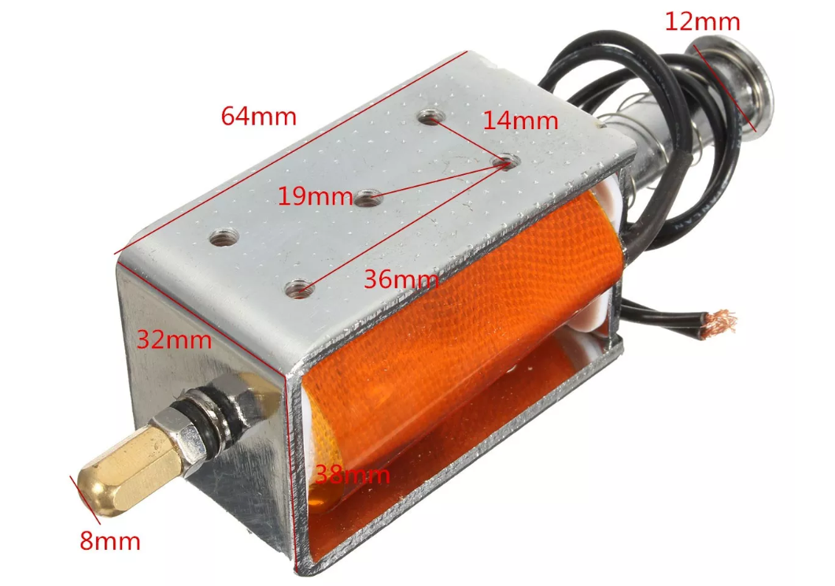
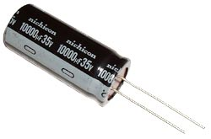

HELEN-V
PROJECT DESCRIPTION
“Design and construct one of the two teleoperated robots trying to shoot and score in opponent’s goal.”
Robots can hit, push or otherwise drive the ball but not grasp, scoop or otherwise carry it.
Successive contacts with the ball are allowed but the ball must be transferred to opponent’s half-field in no more than 20 seconds.
The player scoring 2 goals more than the opponent wins the game.
The game is started, upon command, with robots placed on their own goal lines and the goal at the center of the field.
Outstanding Features
Holonomic Control with omni wheels
Powerful shooting with discharging capacitors
User friendly control with classic style joystick
DELIVERABLES
HELEN-V
Eachine ROTG02 FPV Receiver
Command Transmitter Module
Artengo beach volley ball
The playfield walls
User Manual
TECHNICAL SPECIFICATIONS
Robot Part |  | Controller Part
Physical Specification |  | Physical Specification
Height | 21 cm | Size (height x length x width) | 50 x 26.5 x 17 cm
Diameter | 29 cm | Weight | 0.8 kg
Weight | 2.6 kg
Power Specifications |  | Power Specifications
Stand-by power | 4.8 W | Stand-by power | 1.56 W
Operating power | 49.5 W | Operating power | 1.56 W
Operating time | ~45 min | Operating time | ~5 hour
BUDGET
Product | Pcs | Unit Price($) | Total Price($)
nrf24l01+ | 2 | 1.78 | 3.56
TS5828s | 1 | 7.70 | 7.70
Camera | 1 | 6.27 | 6.27
Video Receiver | 1 | 21.99 | 21.99
Arduino Uno | 1 | 3.21 | 3.21
Arduino Mega | 1 | 5.95 | 5.95
Joystick | 1 | 2.84 | 2.84
15dBi antenna | 1 | 2.24 | 2.24
12V Battery | 1 | 9.55 | 9.55
Powerbank | 2 | 4.75 | 9.50
DC motor | 3 | 8 | 24
L298n | 2 | 1.43 | 2.86
Omni wheel | 3 | 5.42 | 16.27
Solenoid | 1 | 13.5 | 13.5
Mounting and Body | 1 | 15 | 15
TOTAL | 21 |  | 145
Subsystems
Video transfer sub-system 40CH 5.8G 600MW transmitter 150CH Dual Antenna Audio FPV Receiver
Command Transmission sub-system NRF24L01 2.4G Communication Module
Motor-drive sub-system Holonomic Control
Shooting sub-system Push-pull solenoid with 35V Capacitors
References
1.https://infocenter.nordicsemi.com/pdf/nRF24L01P_PS_v1.0.pdf?cp=8_4_0_0 2.“Antenna Theory: Analysis and Design”,2005, Constantine A. Balanis. 3.” Basic Circuit Theory”,1969, Charles A. Desoer.
Test Results
Outdoor Range | 237 m
Indoor Range | 67.58 m
Robot Speed at Gear 1 | 10.35 cm/s
Robot Speed at Gear 2 | 30 cm/s
Average Speed of the Ball | 204.54 cm/s
Shooting Range | > 6 m
Special thanks to Assist.Prof.Dr MUSTAFA MERT ANKARALI for his support throughout this project

